Slide 1

Misty robot tutorial
Raymond H. Cuijpers
Associate Professor Cognitive robotics & Human-Robot interaction
Human-Technology Interaction

Slide 2
Overview
Hardware
Software
Documentation
Android/iOS app
Web interface + Python interface (RESTful)
On-robot programming
Javascript
C#

Slide 3
Hardware

Slide 4
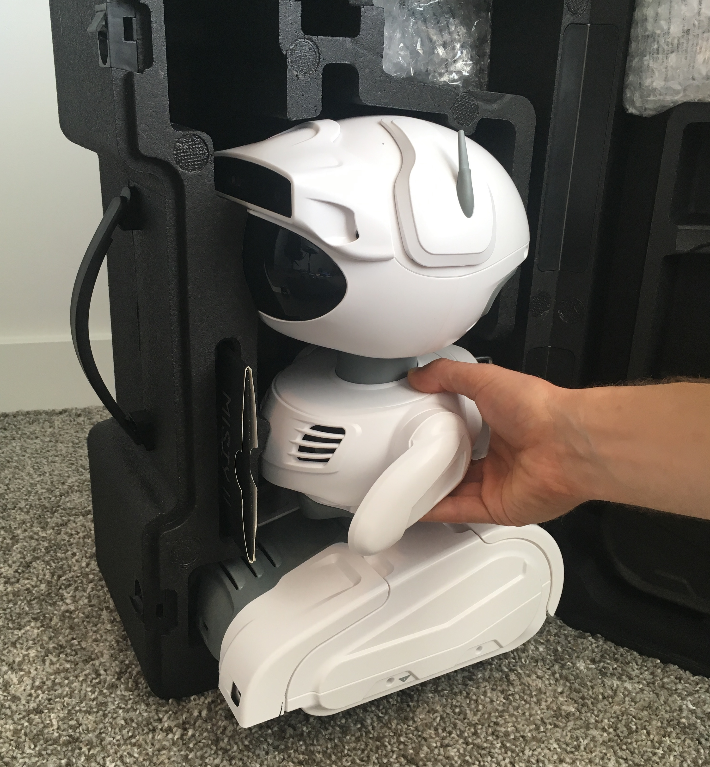
Documentation
Documentation can be found at:
https://docs.mistyrobotics.com
Please read “Misty II Overview” first.
To take Misty out of the suitcase:
Do not pull on the arms
Do not use force
To put Misty in the suitcase:
Make sure the arms are slightly inclined as shown in the picture

Slide 5
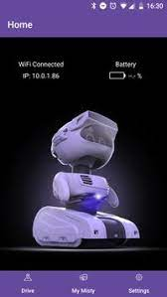
The Misty app
Needed to set-up the wifi connection of the robot
Useful for identifying IP address of the robot and other status information
Provides tele-operation tool
Note: you do not need this with our pre-configured router,
IP address is 192.168.0.100

Slide 6
The Misty app - set-up wifi connection
Power up your Misty robot and wait for her eyes to appear fully open.
Turn on Bluetooth on your phone/tablet and make sure your device is connected to your preferred Wi-Fi network.
Launch the Misty App.
with the Misty App open on your device.
Select your Misty from the list. Note: you may need Misty's serial number by checking the label on the bottom of your robot.
Select your network from the list, and follow the prompt to enter your password.

Slide 7
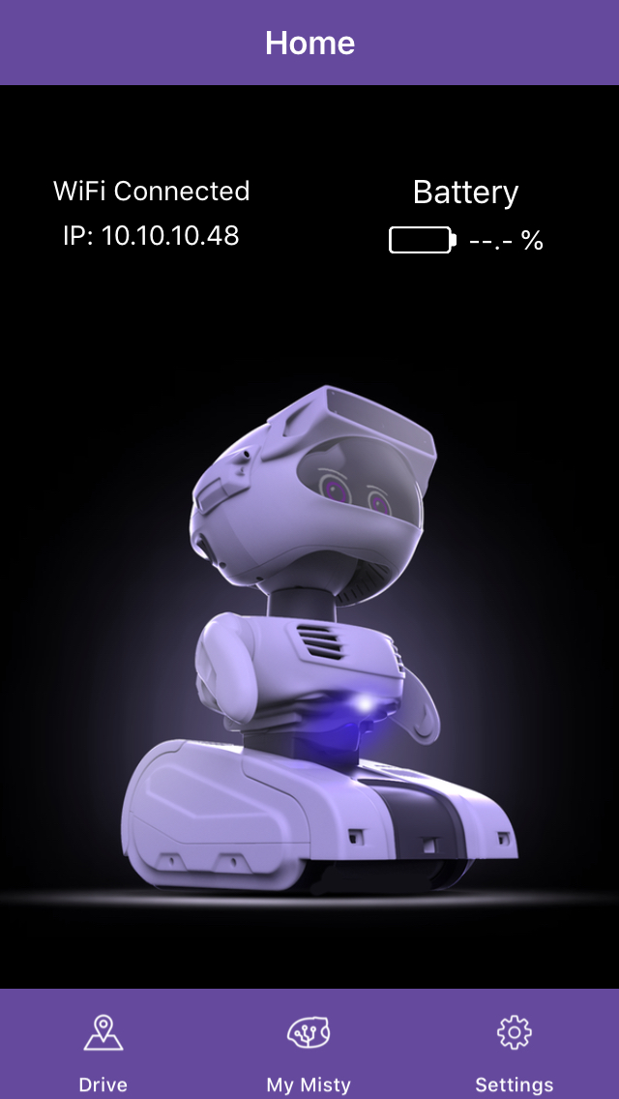
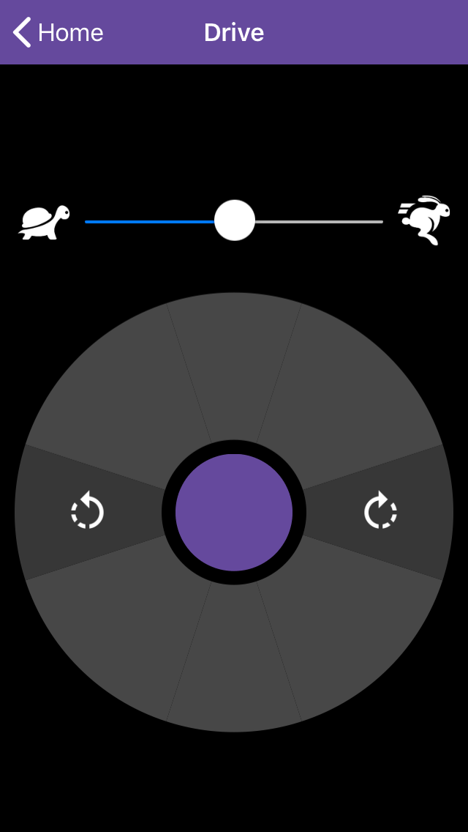
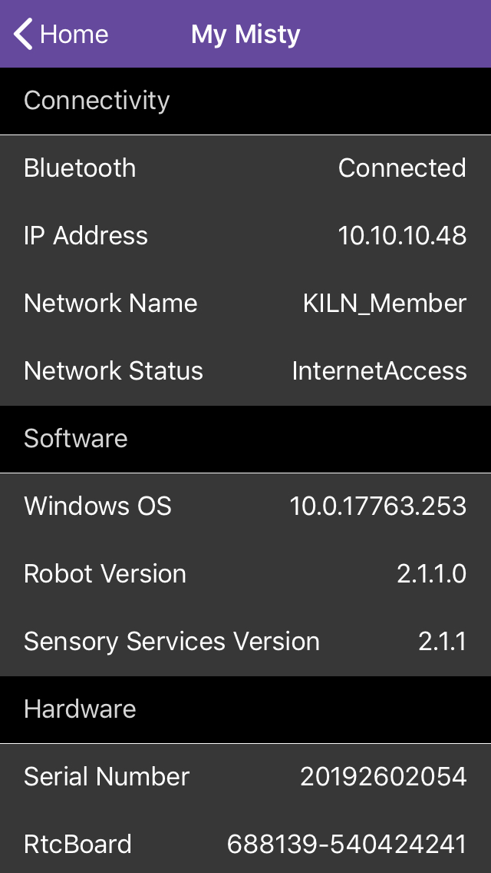
The Misty app – status info & teleoperation
Using the settings menu and the home screen you can find the robot’s IP address and the state of the battery (among others)
Using the drive menu, you can:
move forward and backward
Turn left/right
change speed

Slide 8
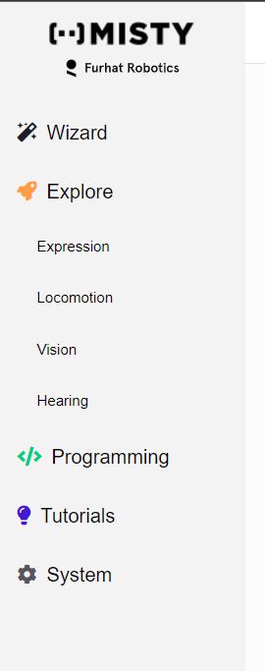
Web Interface
Open the web browser and go to Misty’s ip-address, usually 192.168.0.100
Enter your robot's IP address in the upper-right hand corner of the page and click the Connect button
Wizard – Simple web interface to operate the robot
Explore – Advanced web interface to interact with the robot
Programming – Access to Blockly and Local Python version on the robot
Tutorials – Please do all three of them!
System – not needed

Slide 9
Web Interface
For wizard-of-Oz style of experiments:
Choose Explore from the left menu

Slide 10
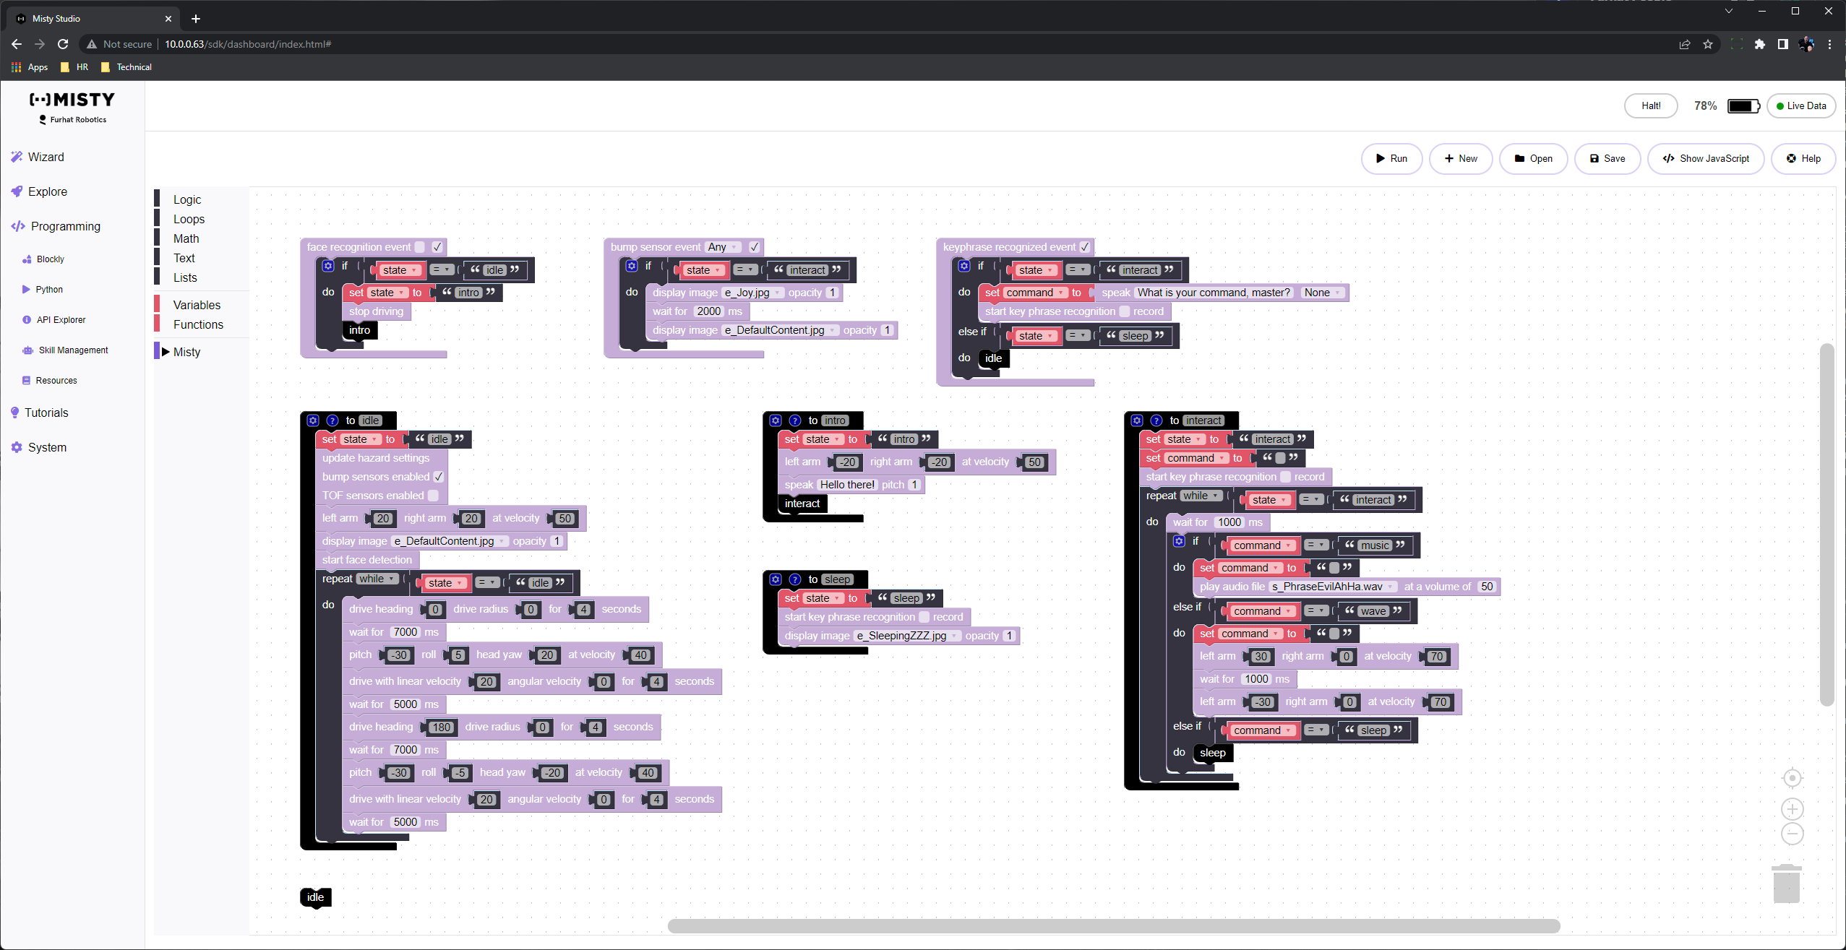
Web Interface
For Blockly programming
Choose Programming from the left menu and choose Blockly
Tutorials/lessons are here https://lessons.mistyrobotics.com/blockly/blockly-lessons
You can download your local copy here: https://github.com/MistyCommunity/Blockly

Slide 11
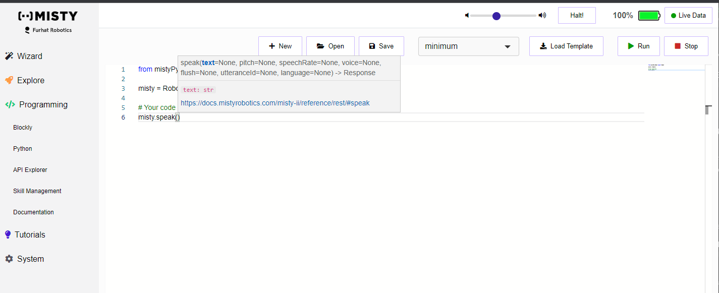
Web Interface
For Python programming using the web interface
Choose Programming from the left menu and choose Python
Tutorials/lessons are here https://lessons.mistyrobotics.com/python/python-lessons
Works great for autonomous behaviours, but is limited to pre-installed python of the robot

Slide 12
Web API
Writing a robot application with Misty’s Web API typically involves two things:
sending requests to Misty's HTTP API endpoints
getting live data from Misty's sensors and other event types via WebSocket connections
There are different ways to send HTTP requests - for example, by writing HTTP client code, or by using the API Explorer or a REST client tool on a laptop connected to the same network as Misty
See https://docs.mistyrobotics.com/misty-ii/web-api/overview/ for an overview
See https://docs.mistyrobotics.com/misty-ii/web-api/api-reference/ for the API reference guide

Slide 13
Python API
The WEB API can also be accessed from Python.
Using Python 3.8 or higher do:
pip install Misty-SDK
It will also install
requests>=2.25.1 websocket-client<=0.57.0 yapf>=0.30.0
See https://github.com/MistyCommunity/Python-SDK for details and examples.
Great if you want to use OpenCV or Mediapipe for advanced image processing
Python 3.10 recommended
https://ai.google.dev/edge/mediapipe/solutions/setup_python

Slide 14
Skill programming
It is also possible to program the robot directly using javascript or C#
These so-called skills run on the robot and are needed for real-time interaction. For most purposes this can also be done using the Python API except that the robot needs to be connected to wifi
See documentation for details
See https://github.com/MistyCommunity/Documentation for examples
It is also possible to access skills from a Python using a remote computer using the requests, json and websocket packages directly. You can send and receive http requests using the REST interface of the WEB API. However, this is already implemented in the Misty-SDK for Python, so it is better to use that instead.

